Slide 1
Lab 10 Thread_Local_Storage and Thread Cancellation Points
Teacher: Hsung-Pin Chang
TA: Yung-Hsu Chu

Slide 2
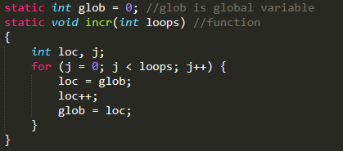
Why we need “thread-local storage”
A function is said to be “thread-safe” if it can safely be invoked by multiple threads at the same time
Why the following function is not thread-safe?
If multiple threads invoke this function concurrently, the final value in glob is unpredictable

Slide 3
GLOB = 0
THREAD 1 | THREAD 2
LOC=GLOB
LOC++
GLOB=LOC
 | LOC=GLOB
 | LOC++
 | GLOB=LOC
GLOB = 2
GLOB | LOC
1 | 2
GLOB | LOC
2 | 2
GLOB | LOC
0 | 0
GLOB | LOC
0 | 1
GLOB | LOC
1 | 1
GLOB | LOC
1 | 1

Slide 4
GLOB = 0
THREAD 1 | THREAD 2
LOC = GLOB
LOC++
 | LOC = GLOB
GLOB=LOC
 | LOC++
 | GLOB=LOC
GLOB = 1
GLOB | LOC
1 | 1
GLOB | LOC
0 | 0
GLOB | LOC
0 | 0
GLOB | LOC
0 | 1
GLOB | LOC
0 | 0
GLOB | LOC
0 | 1

Slide 5
Why we need “thread-local storage”
(cont.)
This function illustrates the typical reason that a function is not thread-safe: it employs global or static variables that are shared by all threads.
thread-local storage provides persistent per-thread storage

Slide 6

thread-local storage
global or static variables
global or static variables
global or static variables
global or static variables
thread

Slide 7
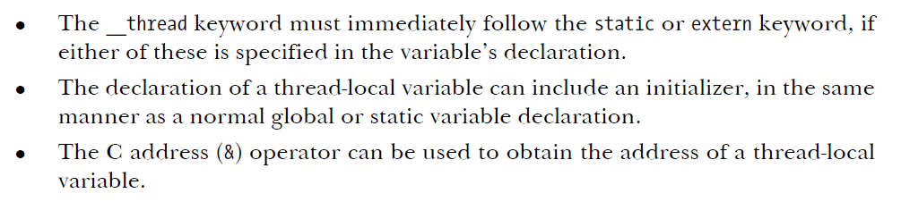
How to declare thread-local variable
To create a thread-local variable, we simply include the __thread specifier in the declaration of a global or static variable:
Note the following points about the declaration and use of thread-local variables:
Example : static __thread int x;

Slide 8
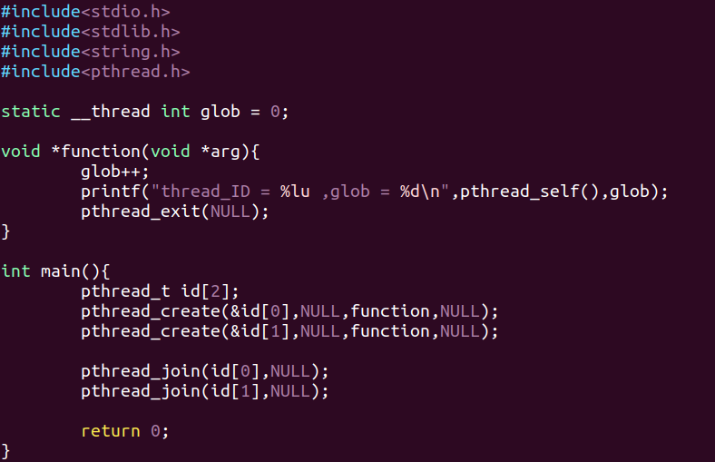
Example1

Slide 9
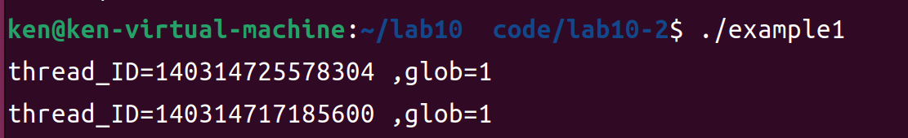
Example1(cont.)

Slide 10
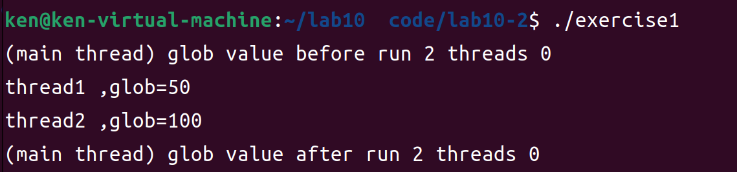
Exercise1 (40pts.)
Modify example1 code and implement “incr function”(ppt.2)
,the value of “loops” parameter is passed by pthread_create()
Execution result as shown below:

Slide 11
Thread cancellation
Typically, multiple threads execute in parallel, with each thread performing its task until it decides to terminate by calling pthread_exit() or returning from the thread’s start function.
Sometimes, it can be useful to cancel a thread; that is, to send it a request asking it to terminate now.

Slide 12
Cancellation Points
When cancelability is enabled and deferred, a cancellation request is acted upon only when a thread next reaches a cancellation point.
A cancellation point is a call to one of a set of functions defined by the implementation.

Slide 13
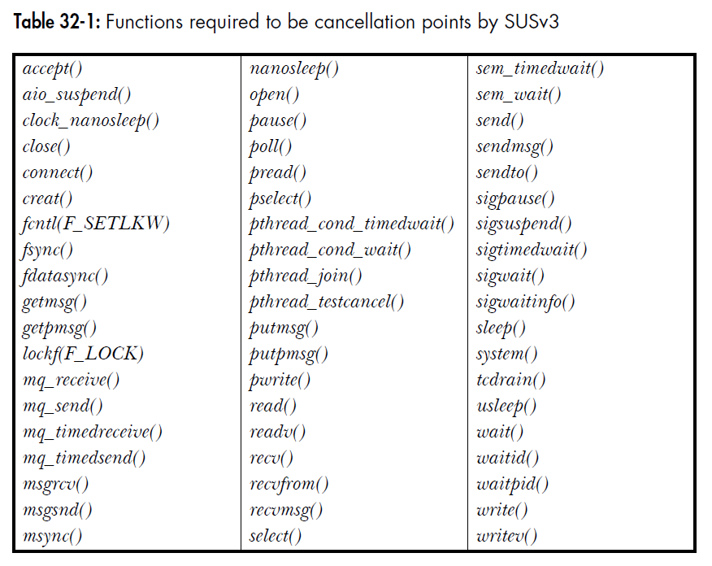
Cancellation Points(cont.)

Slide 14
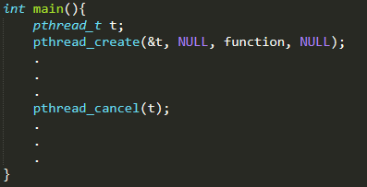
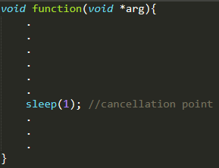
Cancellation Points(cont.)
Main thread
Thread1
receive a cancellation
request from main thread
Send a cancellation
request to thread1
Thread1 terminate

Slide 15
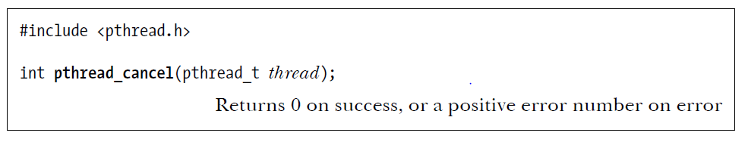
Cancellation Points(cont.)
The pthread_cancel() function sends a cancellation request to the specified thread.

Slide 16
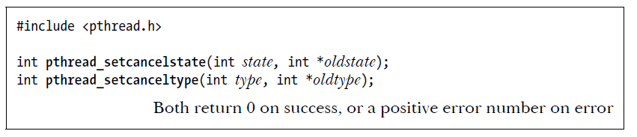
Cancellation Points(cont.)
The pthread_setcancelstate() function sets the calling thread’s cancelability state to
the value given in state.
state:
PTHREAD_CANCEL_DISABLE：The thread is not cancelable
PTHREAD_CANCEL_ENABLE：The thread is cancelable (Default)
oldstate:
If we are not interested in the previous cancelability state, Linux allows oldstate to be specified as NULL

Slide 17
Cancellation Points(cont.)
If a thread is cancelable (PTHREAD_CANCEL_ENABLE), then the treatment of a cancellation request is determined by the thread’s cancelability type.
type:
PTHREAD_CANCEL_ASYNCHRONOUS：The thread may be canceled
at any time
PTHREAD_CANCEL_DEFERRED：The cancellation remains pending until a cancellation point is reached (Default)
oldtype:
If we are not interested in the previous cancelability type, Linux allows oldtype to be specified as NULL

Slide 18
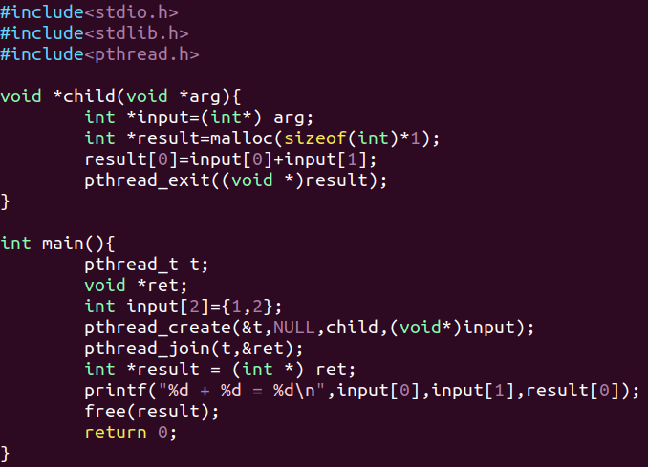
Example2

Slide 19
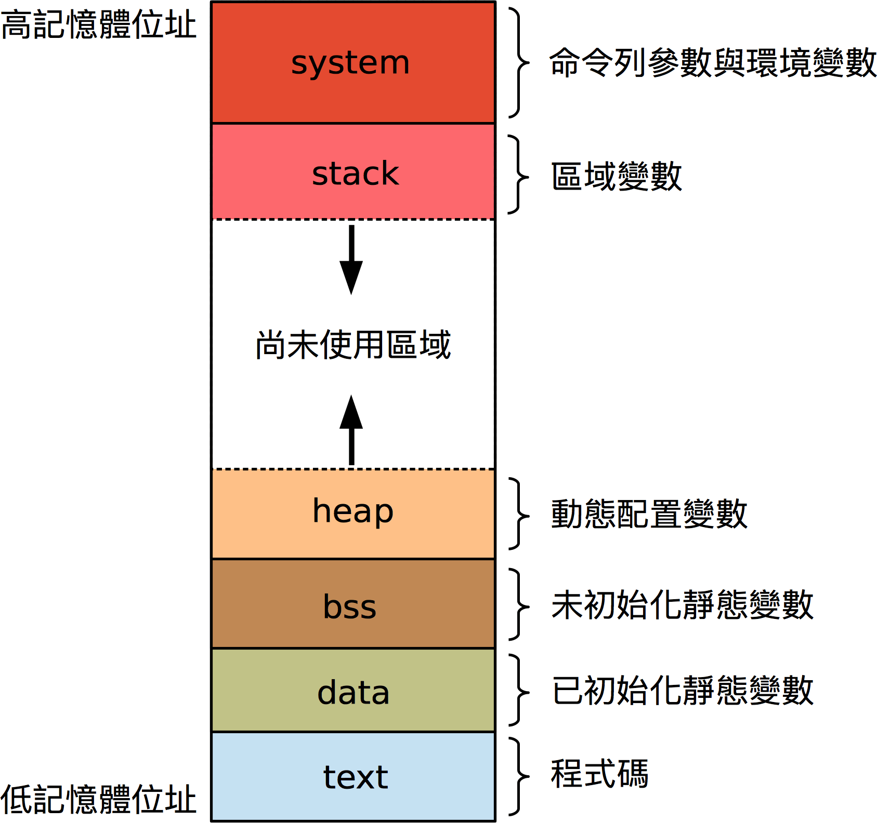
Exercise2 (50pts.)
③ Global pointer
②
①Call Malloc()
④200
⑤Call free()
int *gptr = malloc(sizeof(int))
*gptr = 200
*gptr = X

Slide 20
Example2(cont.)

Slide 21
Exercise2 (50pts.)
Modify example2 code and observe the following situation：
When the thread has completely calculated, the main thread will send cancellation request to terminate the thread before it call pthread_exit()
Observe that the thread if system resource without appropriate release when suddenly terminate , the system resource will be recycled by OS or not?

Slide 22
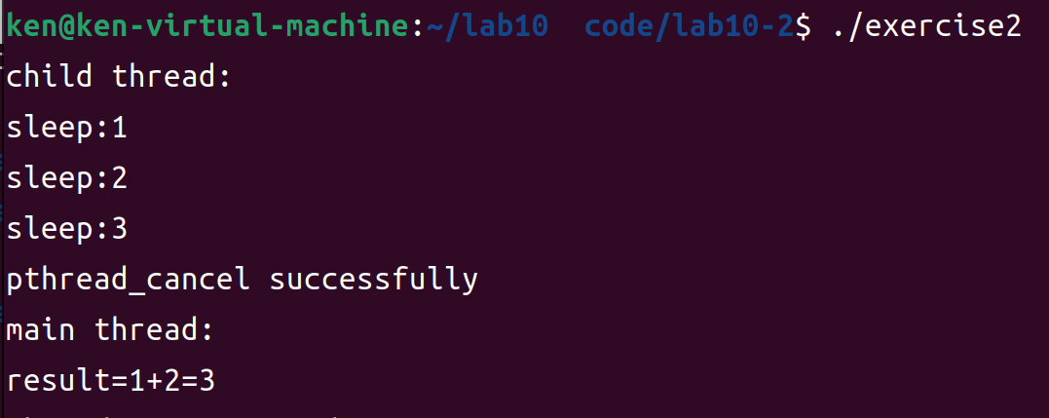
Exercise2 (50pts.) (cont.)
Execution result as shown below:
Child thread will receive cancellation request after 3 seconds
Main thread sent cancellation request to child thread
Calculated result still exist because child thread without release assigned memory

Slide 23

Reference
The Linux programming interface : a Linux and UNIX system programming handbook

